Slide 1
Participation Guide
Presented by Hannah Frost, Stanford University ~ Samvera Connect 2021
Notes:
Samvera is dedicated to providing a welcoming and harassment-free community experience for everyone. From the very beginning, the Samvera open source collaborative has been committed to openness and transparency in all that it does: code, designs, discussions. We are equally committed to helpful and respectful communication.
Historically, women, people of color, people with disabilities, and other marginalized groups have been excluded from technology work, and ironically, from open source software communities in particular. The Samvera community is committed to removing any barriers to participation wherever they exist.
(let’s all take a moment to clap for that!)
In recent years, it has been our custom to open the conference with a presentation on the topic of our community values and our shared expectation to reflect those values in how we behave and communicate with one another during the Samvera Connect events.
We’ll do that again this year, however I am going to take some of this time on the agenda where we typically elaborate on our values in action and use that time to briefly explain the important changes we’ve instituted this year to strengthen the safety of our community and its members.

Slide 2
Community Values
Agility & Responsiveness to change
Transparency & Openness
Learning & Innovation
Respect & Collaboration
Participation & Contribution
Notes:
The Samvera Community is a vibrant, dynamic, and honestly sometimes turbulent place. We believe one of our major strengths is our ability to work together collaboratively, supporting one another personally and professionally. We’re not perfect and we don’t always get it right, but we strive to apply all of these principles --- each of the values listed here on this slide -- to all our work and interactions.
To the best of our ability, we work to be humble and responsive, not defensive, when someone calls us out on not living up to these intentions.

Slide 3
Code of Conduct & Anti-Harassment Policy
It’s been updated!
You agreed to comply when registering for this event
Accessible at:
bit.ly/samvera-coc-ahp
Link in Slack #connect channel
Notes:
Our community has both an official code of conduct and an official anti-harassment policy. The Code of Conduct expresses our aspirations about how we want to work and interact.
The anti-harassment policy provides a framework to promptly and supportively assist any member of the community who feels subject to any form of harassment. It specifies unacceptable behavior and its implications. This policy is only one aspect of our broader intention to maintain a diverse and welcoming community that encourages contribution from all participants without bias.
Both of these documents have been updated this year (I’ll say a bit more about that later). We expect participants at all community events and forums to honor these policies -- and in fact you agreed to comply when you registered for this event.
If you haven’t already, please take time to review the documents today. They are posted on the wiki, and you can get there via th bit.ly link posted here, by the link posted in the fine print at the top of the #connect channel in Slack.

Slide 4
Slackbot to the rescue
Notes:
We also created a custom Slackbot. You can simply type the phrase “get COC” -- that’s g-e-t space c-o-c -- into any channel in Samvera Slack, and the link will magically appear.
Here’s a screenshot showing what that looks like.

Slide 5
How to Get Help (with anything)
And especially if you feel, or think another attendee may feel, threatened or unsafe in any way:
Send email to: helpers@samvera.org
Contact individuals (see next slide) via:
Slack private message
Zoom private chat
Notes:
With the Code of Conduct and AH policy as a foundation, Samvera community members team up to provide help to those who need it -- any kind of help at all, and especially support in the event someone feels threatened, and there may have been a violation of our Code of Conduct.
There are several ways to get help:
Send an email to helpers@samvera.org. Your message will be received by a small group of vetted volunteers known as the Community Helpers, or just Helpers (their names are shown on the next slide).
Alternatively you can contact people individually as a private message on Slack or private chat on Zoom. This is likely the fastest way to get help.

Slide 6
Who is Here to Help
Community Helpers Carolyn Caizzi Hannah Frost Jessica Hilt Brian McBride Rosalyn Metz Alicia Morris Bess Sadler Simeon Warner
Program Committee Heather Greer Klein Kevin Kochanski Robin Lindley Ruggaber Karen Cariani Rick Johnson Ilkay Holt
Notes:
This slide lists the current, incoming Community Helpers. Look for us online. We should be easy to find with the Community Helper label next to our names and the rainbow emoji on Slack.
You can also reach out to members of this year’s Connect Program Committee - whose members are listed here.

Slide 7
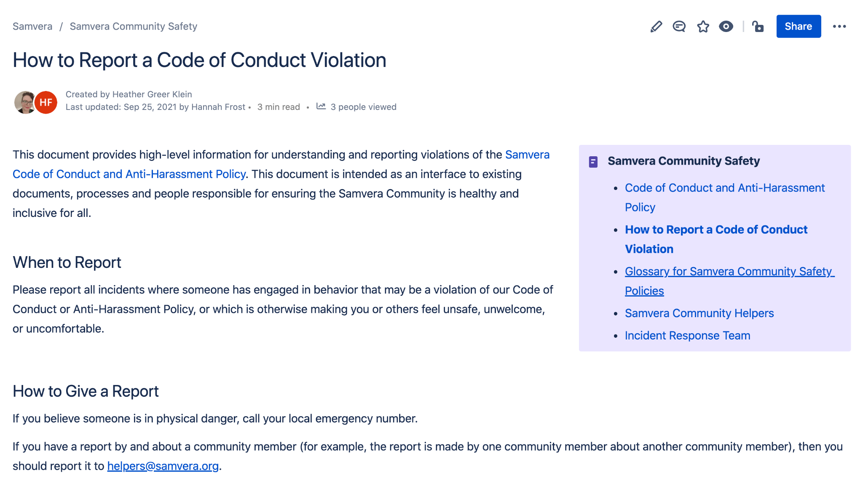
How to Report (and What to Expect)
On the wiki: How+to+Report+a+Code+of+Conduct+Violation
Notes:
If you are considering reporting a potential Code of Conduct violation, or have already contacted the Helpers about your concern, we suggest you reference this new page recently added to the Samvera wiki. It outlines information about the process and what you can expect as it moves forward. Note that this and all the new documentation posted to the wiki under Samvera Community Safety has a menu of links (the lavender box in the upper right) to the set of related pages to facilitate navigation. And to facilitate understanding, we also included - thanks to Jeremy Friesen - a glossary of terms because there are quite a few new terms involved.

Slide 8
How we got here ...
Notes:
Now I am going to switch gears away from talking about the Code of Conduct and the Anti-Harassment policy as they relate to the events of this week.
I’ll spend a few minutes reporting out on the work accomplished over the past year that got us to this point.

Slide 9
The Samvera Community Safety WG
Chartered and working since March 2021 to:
Establish clear, formal process for incident response
Modify Samvera Safety Volunteer structure as needed
Review and revise policies as needed
Draft community guidelines
Notes:
It was the purpose of the Samvera Community Safety Working Group, which has been working formally since March of this year, to carry out this work. Namely to:
Establish clear, formal, documented process for incident response
Modify Samvera Safety Volunteer structure as needed
Review and revise policies as needed
Draft community guidelines.

Slide 10
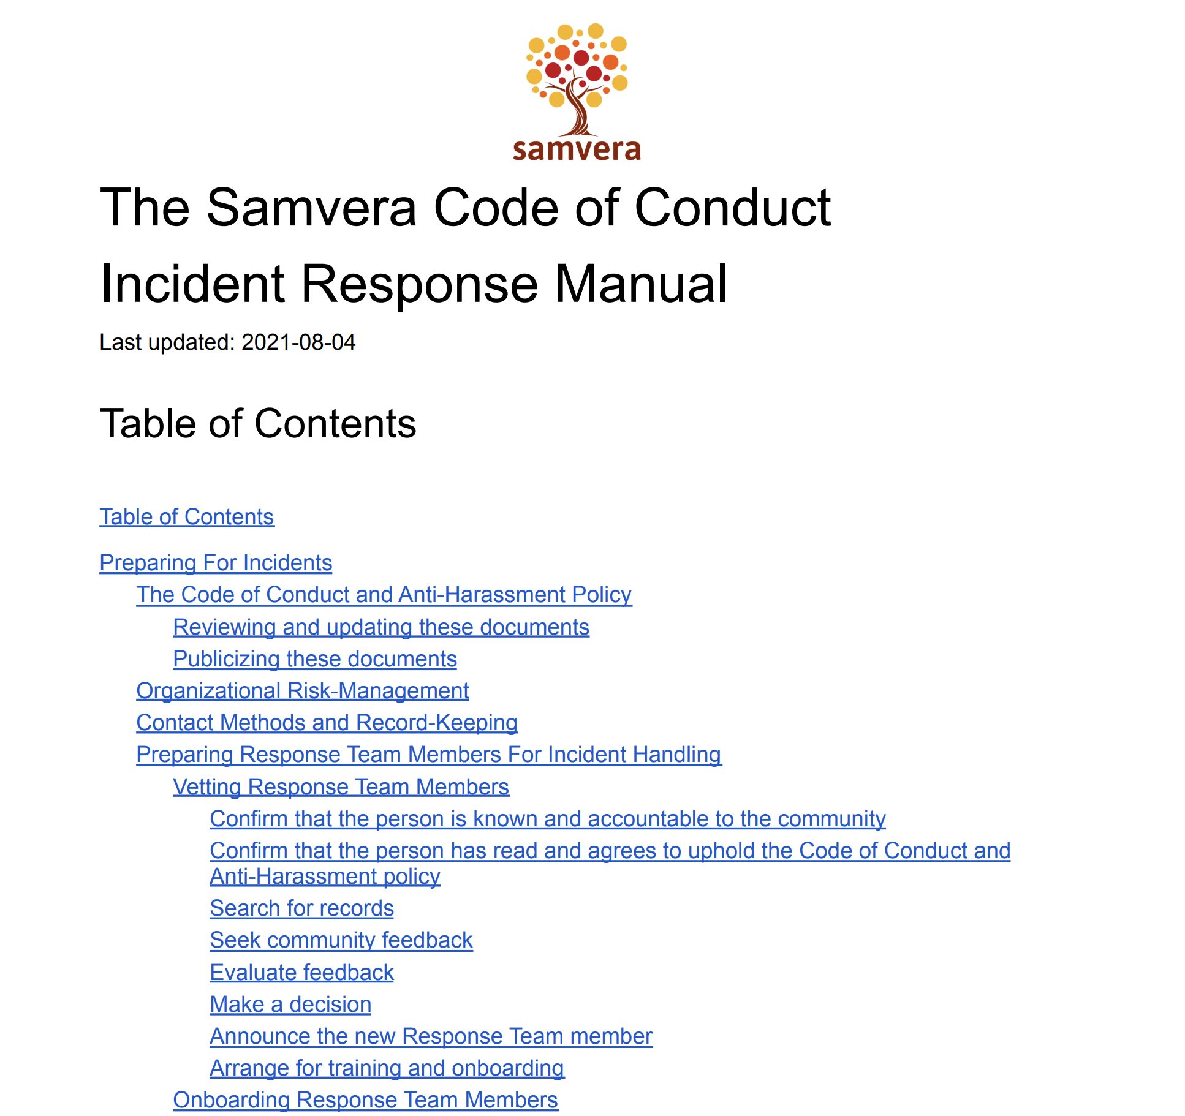
Process for Incident Response
✅
To be reviewed annually
PDF available on Response Team Page
Notes:
With the invaluable help of our consultant, Annalee Flower Horne, Samvera now has an in-depth, comprehensive incident response manual. It is linked to the Incident Response Team page, and is scheduled to be reviewed for any changes or updates on an annual basis.

Slide 11
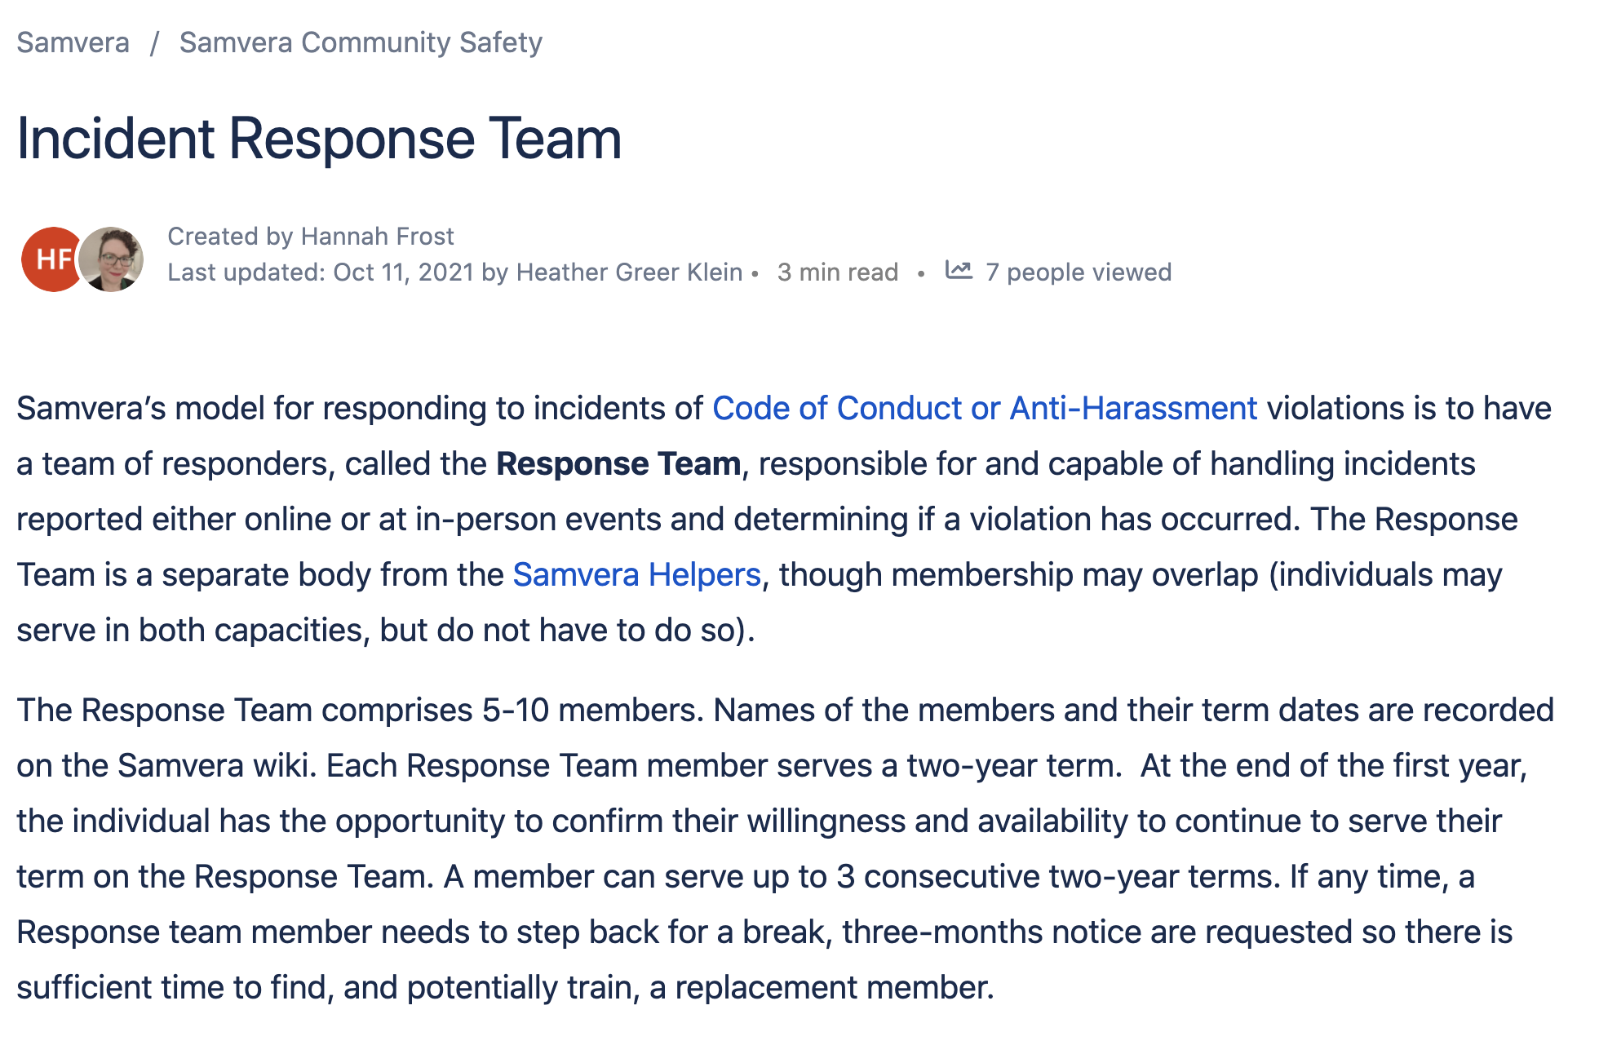
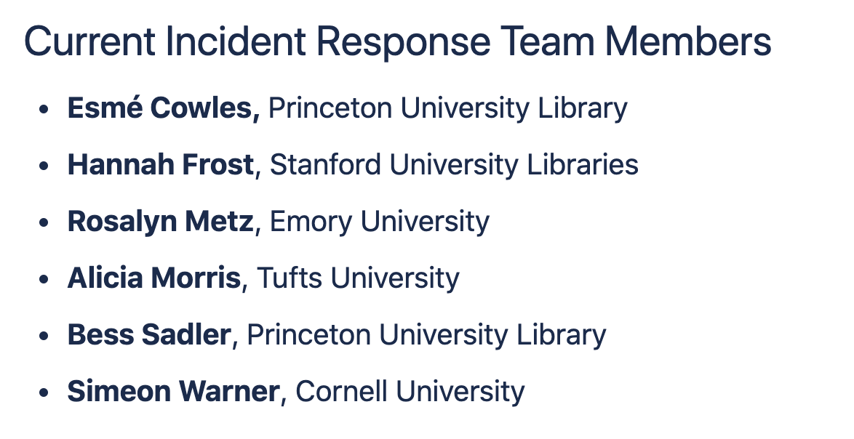
2. Modify Volunteer Structure
✅
Split and delineate roles of Helpers & Responders
Codify soliciting, vetting, and terms
Notes:
Our second goal to modify the safety volunteer structure was also accomplished. We have separated the roles of Community Helpers and Incident Responders, and clearly delineated their distinctive responsibilities. You can read about that on the wiki. We have also codified and implemented a process for soliciting and vetting volunteers to fill these roles, and have defined the length of a term for serving in one of these roles.
We saw the list of new Helpers a couple of slides ago. Now is a good time to present the folks who have volunteered to serve on the Incident Response Team. In addition to myself, the list includes:
Esmé Cowles
Rosalyn Metz,
Alicia Morris
Bess Sadler and Simeon Warner.
While I hope that we never have to work together, in the event that we do, I am confident we all feel well prepared.

Slide 12
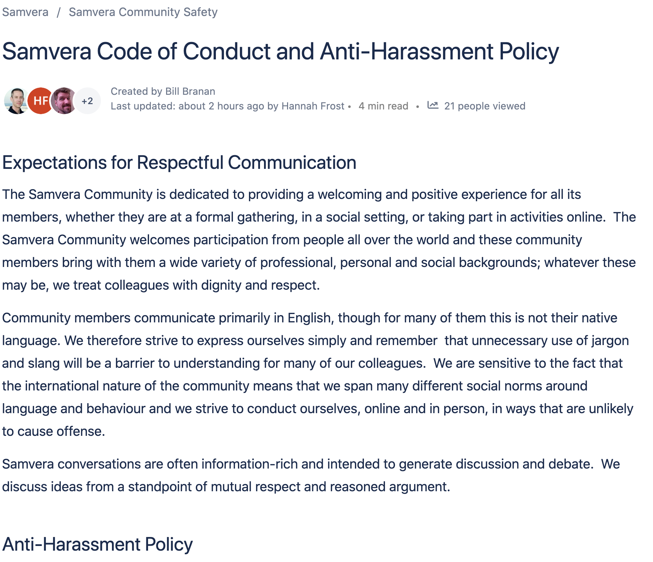
3. Review and Revise Policies
Combine into one document; edit for clarity, redundant language
Readily available and reviewed annually
✅
Notes:
After those components came into place, that’s when we turned to reviewing and revising the Code of Conduct and AH Policy. These used to be two relatively disjointed pages; they are now combined into one and have been edited for clarity with redundant or now irrelevant language eliminated.
The policies are now readily available and scheduled for annual review by the safety volunteer teams.

Slide 13
4. Community guidelines
Still pending
Notes:
A fourth and final goal -- tacked on to our charge as a nice-to-have -- is to formally draft Samvera’s first ever community guidelines. We had hoped to have this in place for Connect, but the work has been delayed.
Our aim now is to complete this before the end of the year, which is entirely feasible, so stay tuned for an update on that.

Slide 14
The Community Safety Working Group
Chris Awre Jon Cameron Jeremy Friesen Hannah Frost Jessica Hilt Nabeela Jaffer Michael B. Klein
Heather Greer Klein Kevin Kochanski Brian McBride Rosalyn Metz Alicia Morris Bess Sadler Simeon Warner
Thank you for all your hard work!
Notes:
With that, I want to extend my deepest gratitude to all the members of the Safety Working Group. I believe we all agree that this is important work and we learned a great deal as we worked through it together.

Slide 15
Thanks for your attention. Questions?
Have fun Connecting!

