Slide 1
Extending Hyrax: User Subscriptions and Email Tahir Poduska Cornell University
Samvera Connect Lightning Talk
Nov 8, 2017
Using Hyrax search builder to manage user subscription to Publications for USDA Economic, Statistics, and Market Information System

Slide 2
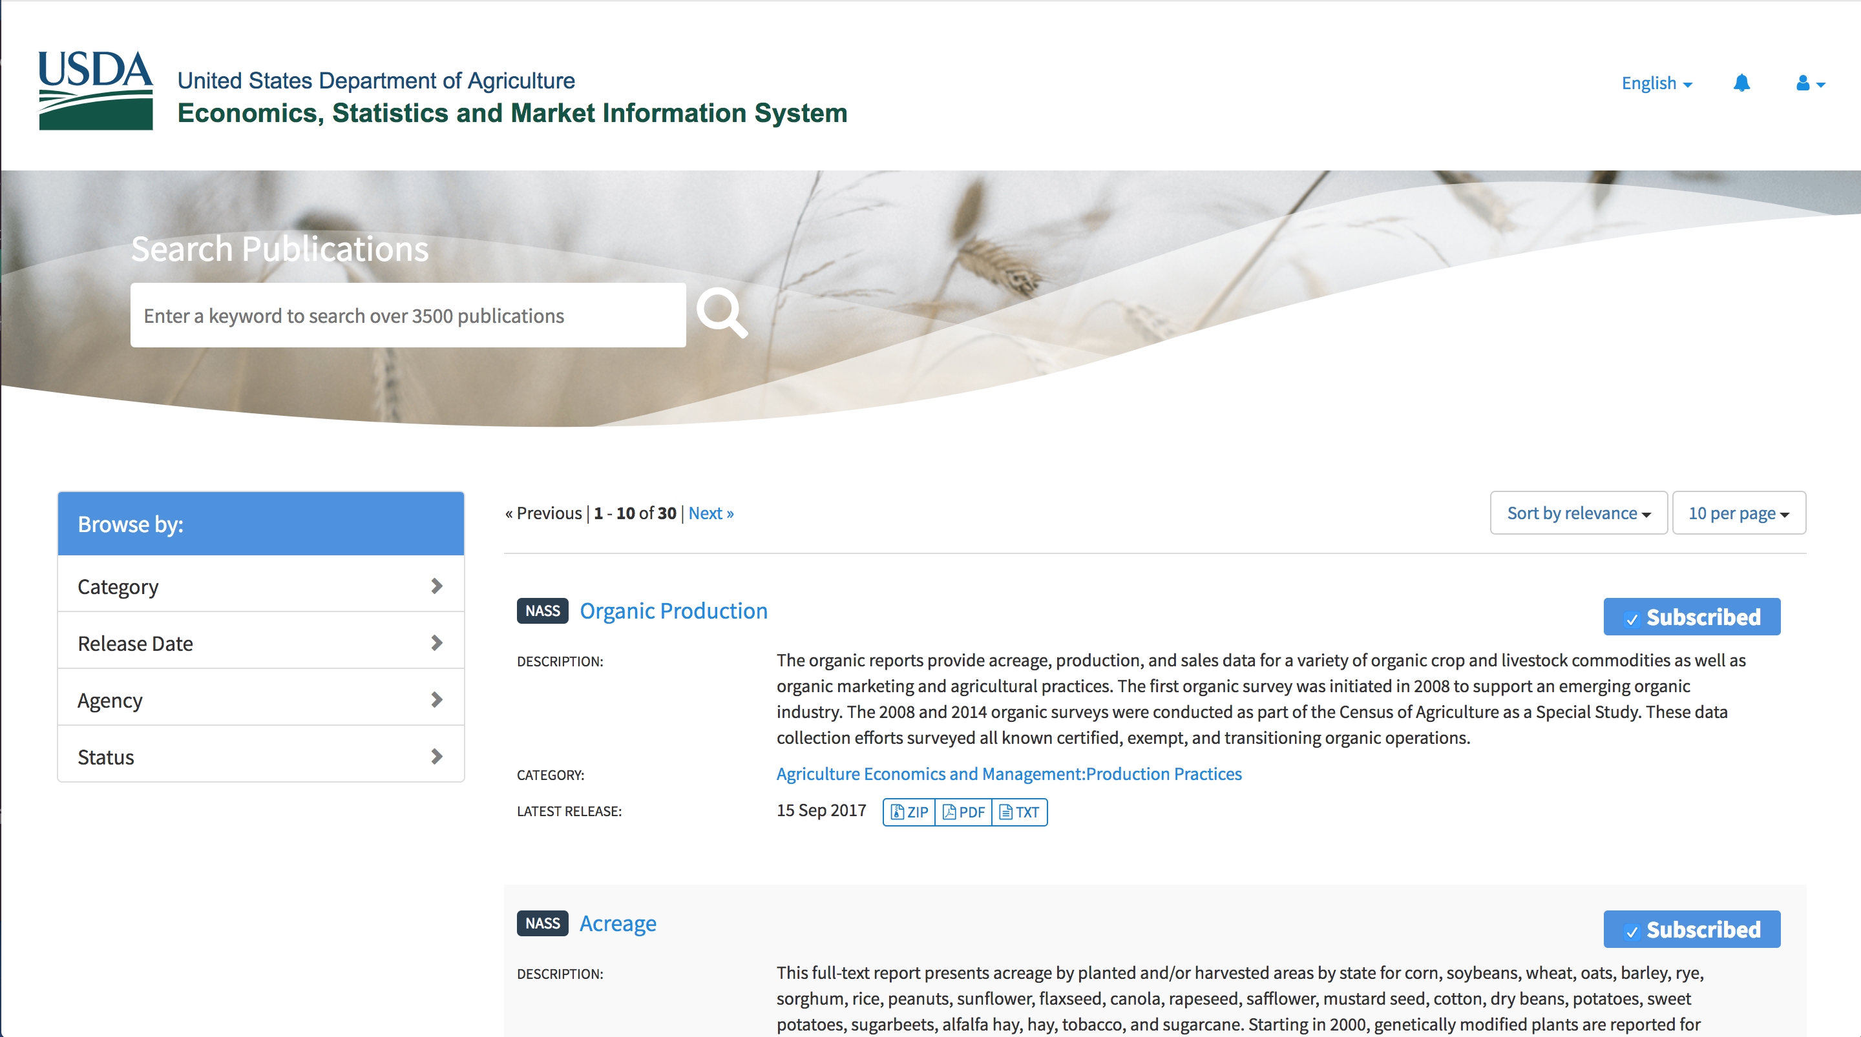
Subscription to Publications
ESMIS uses a nested works: Publications are parent work with metadata but no files. Releases are child works with files
Users can Subscribe to Publications and get emails when a new release is added to the Publication

Slide 3
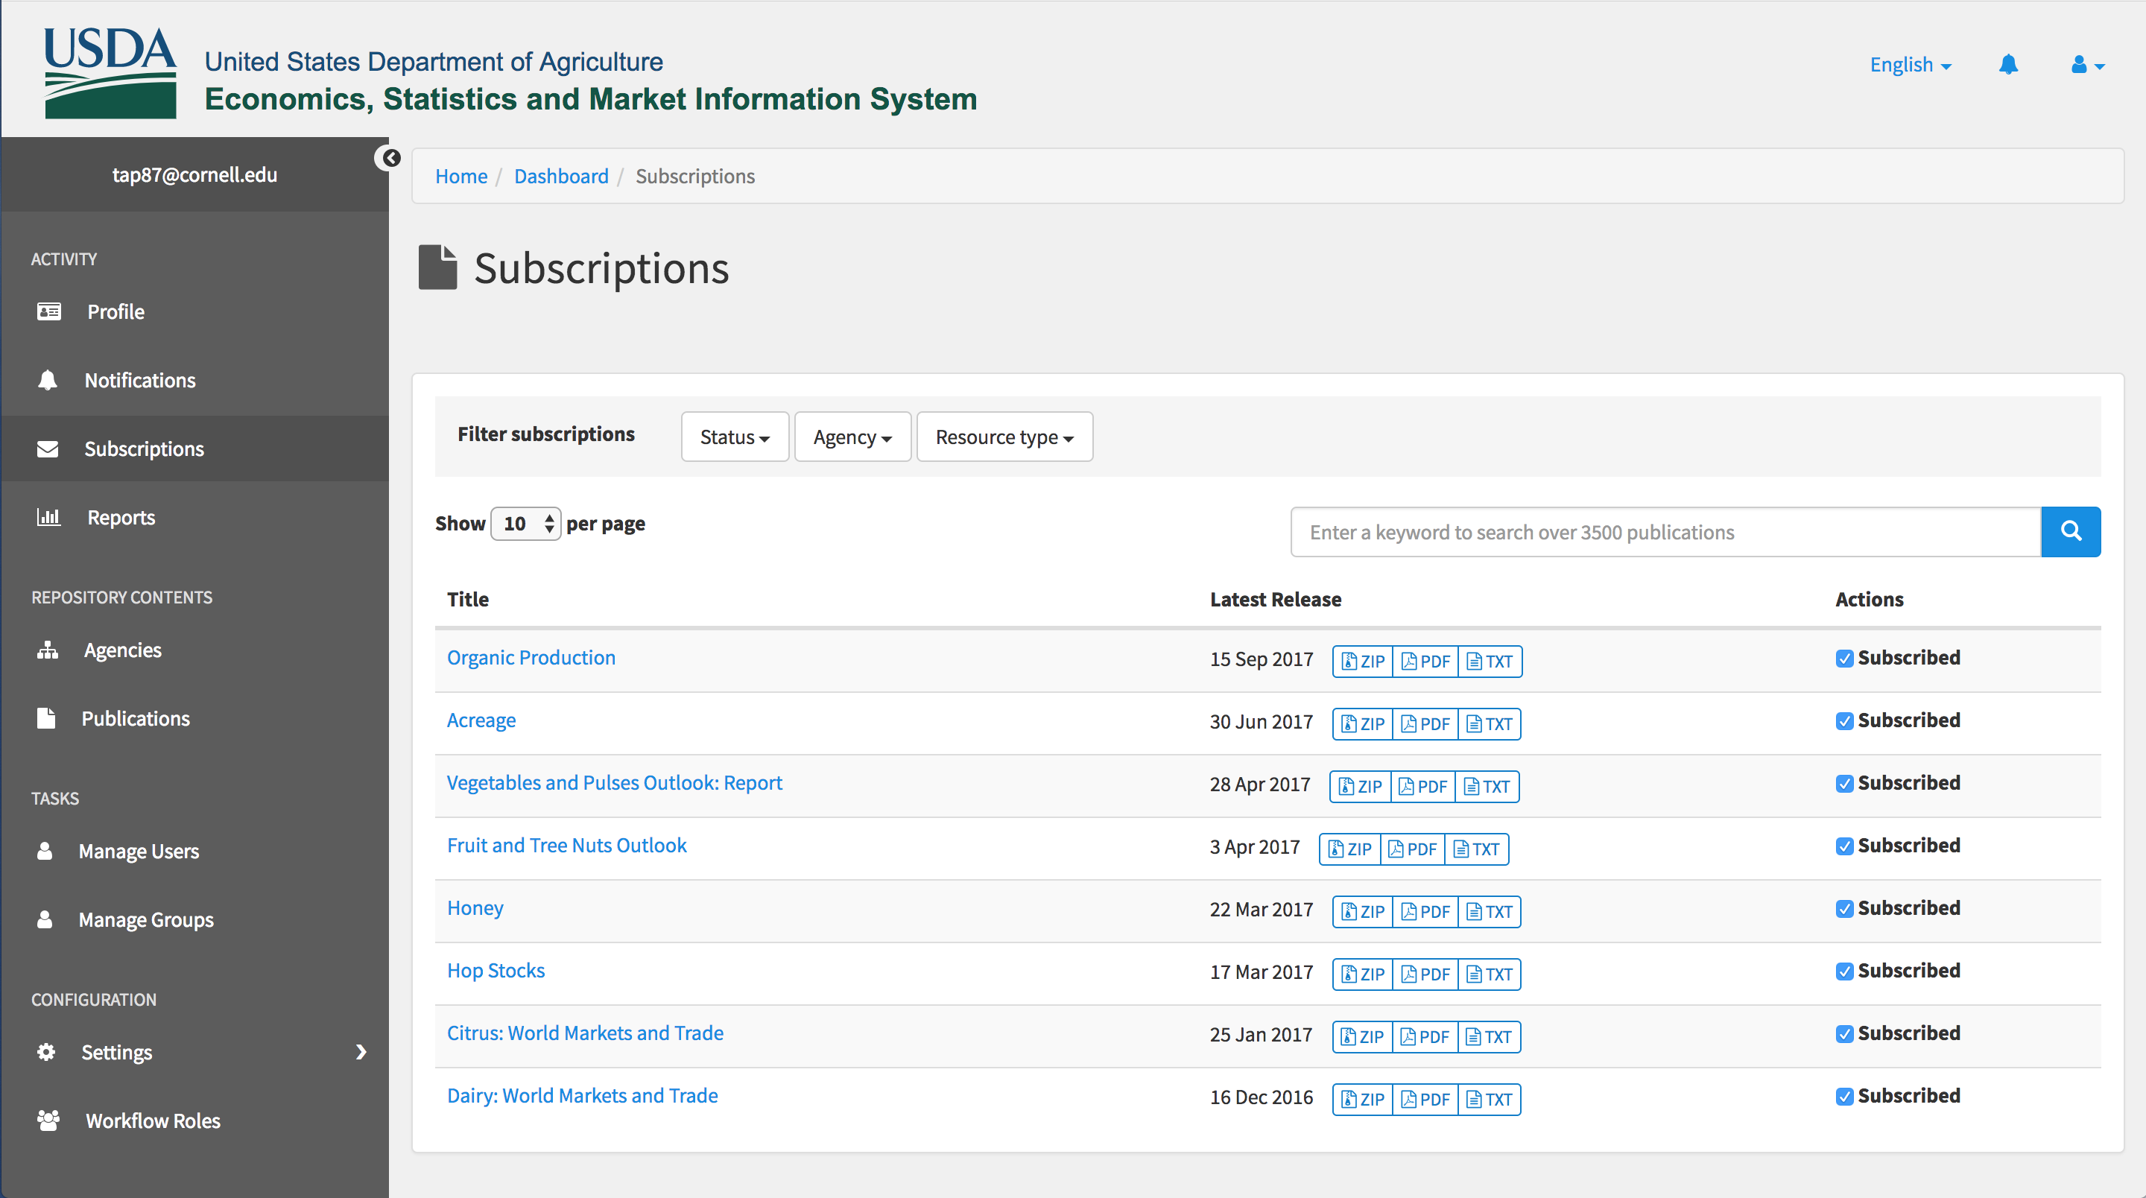
User Subscriptions
Users can manage their subscribed publication in the Dashboard
List build using Hyrax Search Builder

Slide 4
Mailing Lists and Email
Mailgun API for managing mailing lists, subscriptions, and sending emails
Background jobs for managing mailing lists and sending emails via Mailgun

