Slide 1
Using mocks to test external dependencies in an Elixir application
Samvera Connect 2021
Brendan Quinn
Senior Developer, Northwestern University Libraries
Notes:
I’m probably going to say “we” a lot, and by “we” I mean myself, Michael Klein and Karen Shaw (who both presented yesterday!)

Slide 2
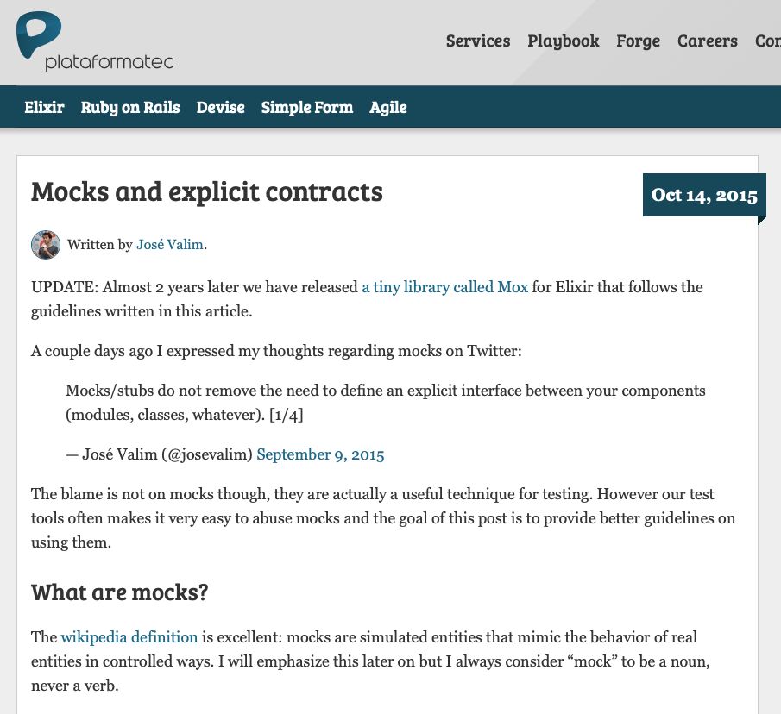
What is a mock?
José Valim, the creator of Elixir, wrote in a blog post way back in 2015:
“The wikipedia definition is excellent: mocks are simulated entities that mimic the behavior of real entities in controlled ways...I always consider ‘mock’ to be a noun, never a verb.” http://blog.plataformatec.com.br/2015/10/mocks-and-explicit-contracts/
Notes:
How I like to think of “noun vs. verb”: a mock is a thing in your system not something your system does.

Slide 3
Goals
Gain confidence in code that calls external APIs outside our control
Avoid making external HTTP requests while running tests (slow, rate limits, connection requirement)
Make tests easier to write
“We’re not talking about ‘magic’ today” (quote attributed to Trey Pendragon)

Slide 4
Three Examples (ordered by complexity…sort of)
MediaConvert.Mock
Authoritex.Mock
Meadow.Utils.ArkClient.MockServer

Slide 5
1. MediaConvert.Mock
Notes:
We use AWS Elemental MediaConvert to transcode audio and video files for streaming. We have lots of tooling to simulate the AWS environment locally (S3, SQS, etc.), but we don't have the ability to simulate MediaConvert transcoding.
We wrote a Mock AWS Elemental MediaConvert mock that is used in both development and test environments.
The mock simulates responses from creating jobs via the AWS MediaConvert HTTP API. Important to note that AWS MediaConvert runs asynchronously, you submit a template with information about source files and transcode settings which creates ”jobs” that run in parallel.

Slide 6
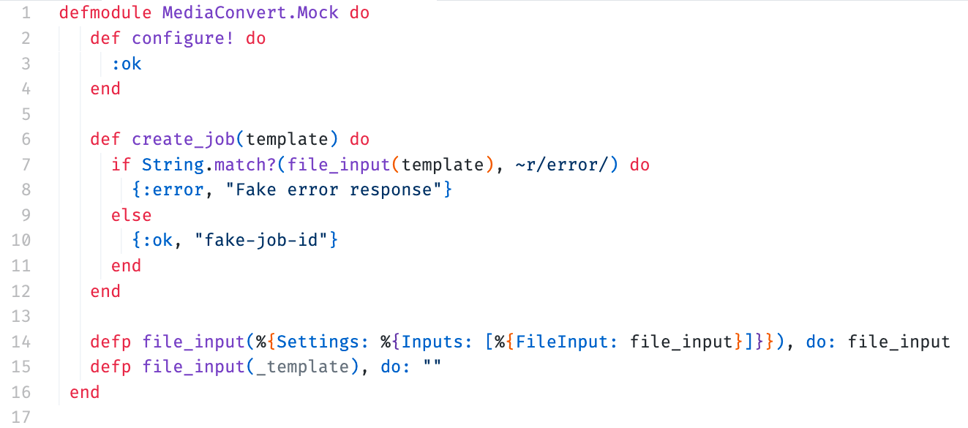
MediaConvert.Mock (initial implementation)
Notes:
Super simple at first, but it allowed us to iterate quickly on the Meadow pipeline action that creates and sends MediaConvert templates to AWS.

Slide 7
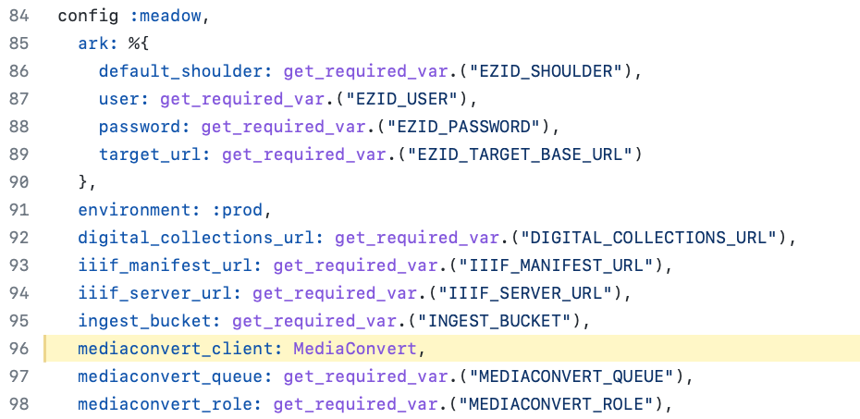
Using the mock
Notes:
We build the templates elsewhere, and then pass those to the MediaConvert modules (both the mock and "real" modules). Which module is called depends on the module stored in our development, test, and production configuration files.

Slide 8
MediaConvert.Mock (latest version)
← Slightly more complex now 😂
Copies files to the streaming bucket
Sends a message to the “TranscodeComplete” action so the pipeline can continue progressing
More robust handling of complete and error events
No changes to configuration or calling code

Slide 9
2. Authoritex.Mock
Notes:
Authoritex is an Elixir library we wrote for searching and fetching controlled vocabulary authority terms, inspired by Questioning Authority.
We needed a way to populate works with controlled vocabulary terms in our test environment, so we wrote a mock! It was also helpful during our migration from a Hyrax repository to Meadow.

Slide 10
Authoritex.Mock
Authoritex library:
The “Authoritex.Mock” module implements the “Authoritex” behaviour (explicit interface for defining fetch and search functions across modules)
The mock adds a few functions to:
initialize a table in an Erlang Term Storage (ETS) in-memory cache to store records
get and set data in the ETS cache
Meadow application:
Test helper calls Authoritex.Mock.init() before the test suite runs
Authoritex.Mock added in the test config: “config :authoritex, authorities: [Authoritex.Mock, NUL.Authority]”
Provide defaults in Meadow.AuthorityCase, with the ability to override

Slide 11
Creating fake authority records
Notes:
ExUnit provides tags in order to pass information from the test to the callback.
By tagging a test, the tag value can be accessed in the context, allowing the developer to customize the test.

Slide 12
3. Meadow.Utils.ArkClient.MockServer
Notes:
The ArkClient.MockServer provides functionality for minting and retrieving fake ARK records in our test environment, backed by a caching layer (an ets table very similar to Authoritex.Mock)
Mock EZID API server for testing Meadow.Ark functionality built using a cowboy webserver and Plug. Cowboy is a simple HTTP server and Plug provides us with a router connection adapter for that web server (think along the lines of rack + Sinatra). The server runs as a child process in the applications supervision tree, and we configure the process to spin up only in our development and test environments. Any process can send messages to the MockServer, so we have asynchronous test support as well.

Slide 13
Meadow.Utils.ArkClient.MockServer
Notes:
Config helper showing the ark configuration and the test config showing where we set the URL for the cowboy webserver.

Slide 14
Meadow.Utils.ArkClient.MockServer
Notes:
The same Client sends HTTP requests to either the “real” EZID Ark server or the local mock server, depending on the environment

Slide 15
We went with a DIY approach, but you don’t have to!

Slide 16
Packages in the Elixir ecosystem
Mox: https://hex.pm/packages/mox
Hammox: https://github.com/msz/hammox
Mock: https://hex.pm/packages/mock
Bypass: https://hex.pm/packages/bypass
ExVCR: https://github.com/parroty/exvcr
note we use ExVCR heavily in Authoritex tests

Slide 17
Thanks!

