Slide 1
It’s Alive!
Building Meadow: A Preservation-First Repository
Michael B. Klein (he/him)
Tech Lead, Repository Development & Administration
Repository & Digital Curation Workgroup
Northwestern University Libraries

Slide 2
Meadow: What, Why, How
Exercise in Agile development from the ground up
Radical departure in:
Workflow
Technical approach
Capability
Notes:
By the time we started this project in the spring of 2019, we were looking for a number of things.
We wanted an exercise in Agile development from the ground up, as well as a radical departure in workflow, technical approach, and system capabilities from what we’d been doing before.

Slide 3
RDC Mission
“Creates, acquires, describes and archives digital objects for long-term preservation and develops as well as deploys software to support the discovery, access, and use of digital resources by members of Northwestern University, scholarly communities, and the public.”
Notes:
We also wanted to get back and think about the workgroup’s mission, and our team’s role in supporting that mission.

Slide 4
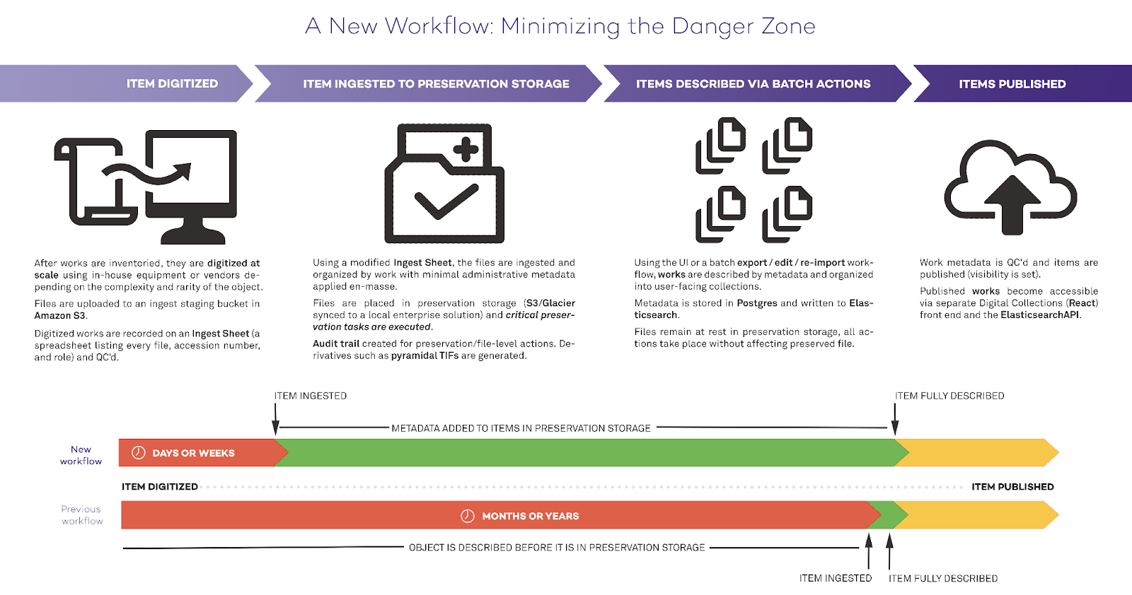
What is “Preservation First”?
Notes:
When we started this project we didn’t just set out to improve our existing system. We took a hard look at our workflow and asked whether the existing repository solution was working the way we wanted to work.
a/k/a WORKFLOW FIRST
That analysis led us to realize that our most important assets were sitting unmanaged for months or in some cases years because our workflow (determined in part by existing repository technology) required us to frontload much of our descriptive work. Basically we had to have everything “done” before it went into the system. So last year we set out to solve that problem.
What we came up with was a workflow and system that front-loads the preservation of assets and seeks to make the describing of assets as frictionless as possible.
The workflow after digitization is broken into three logical steps:
Ingest and Preserve. This is to get assets out of “the danger zone” and into managed preservation. It also makes the assets available immediately for researchers. Our goal is to fit into existing workflows as much as possible. Also, we wanted it to be fast.
Preservation Dashboard – critical to our work. Once an item is in we know that it is safe and we have a report to prove it!
Describe works. During this step, our metadata experts describe the assets in a series of bulk and individual edit operations (CSV and BATCH). This is really a sweet spot for this new product. It massive editing at scale.
Publish and Share. Immediately upon ingestion assets are findable with minimal metadata. We also allow for the ability to share unpublished and access controlled assets via an expiring URL.

Slide 5
Architectural Priorities
Scalability
Efficiency
Repeatability
Visibility
Flexibility
Stability
Usability
Scriptability
Notes:
Scalability – An ingest pipeline and batch operations that can scale out as needed to handle large bursts of work. Karen Shaw will be talking more about that tomorrow afternoon
Efficiency – Makes the best use of provisioned resources; nothing sits idle unnecessarily
Repeatability – e.g., Results are predictable; processes are idempotent
Visibility – Everything has a dashboard! If you’ve made changes to the system, you should be able to get back and see what those changes were and which work(s) were affected
Usability
Completely independent front-end, loosely coupled via GraphQL and Elasticsearch.
Developed using a user-first development process – Adam Arling and Frank Sweis will be talking about that later today
Scriptability
Our Elixir API made it possible for us write our migration code in a matter of days.
The GraphQL API lets us explore and call complex operations from a special web browser scripting interface or from the command line.
Exposing a subset of the Elasticsearch API allows us to plug in automated data harvesting and discovery tools.
Scalability, Flexibility, Stability all led us to Elixir, a 10-year-old language based on the 30-year-old Erlang – designed from the beginning as a rock solid foundation for scalable, concurrent, high-availability systems
In the end: Migration – brought 146,072 works / 209,088 file sets over from DONUT, our Hyrax-based image management system, in just a couple of days with 111 errors, most of which were in the formatting of EDTF dates (our new parser is stricter than the old one). Almost all were easily rectified.

Slide 6
Other Goals
Innovate!
Constantly improve
Share our results
Code (IIIF)
Concepts (ingest pipeline)
Cautionary tales
Notes:
Are we finally doing microservices? I don’t know! Maybe!

Slide 7
What We’ve Learned
We’re pretty good at this!
Testing at scale using realistic data is:
really, really important
really, really hard
Get things into users’ hands early
Watch out for workarounds!
Notes:
What have the past two years taught us? A lot, but I’m going to limit myself to four.
First off, it turns out we’re pretty good at this! Not just the parts we knew we were good at, either.
Even after 30 years of software development and 15 in libraries, I still struggle with obtaining realistic test data. It’s not enough to shove 100 copies of tiff1.tif and test.jpg at your system – you need that 1,000 or 5,000 or 10,000 item test batch with gigabyte TIFFs and all the metadata fields filled out ready much earlier in the process than we had. (See Karen’s talk tomorrow afternoon to find out what happened!)
Don’t let the workaround become the work! People who work in libraries and academia are often so used to devising elaborate workarounds to compensate for shortcomings in the systems they use that it won’t even occur to them to tell you about their 9-step process until you see them doing it.

Slide 8
TOUR / DEMO
Notes:
HOMEPAGE
Repository growth over time
Analytics dashboard (“Has a picture of the impact of his work”)
Let’s start with INGEST
Ingesting assets follows the workflow of the production team. It uses a modified inventory sheet which we produce while digitizing assets to move works into the system. The goal is to make this happen as quickly as we can after QA so that works are preserved and shareable.
Show Spreadsheet
Show ingest happen
A lot has to happen as we move assets into a preserved and shareable state
Checksums (digests) are generated
They’re Moved into preservation storage
Tech metadata is gathered
Works are created
Files are attached to works
BATCH EDIT
Add to John Cage Correspondence collection
Add “Cage, John” as a Topical subject
Add “Personal correspondence” (FAST Form/Genre) as Genre
SHOW CSV METADATA EXPORT
SHOW SHAREABLE LINK (PROD)
SHOW DASHBOARDS

Slide 9
Team / Contact
Adam Arling front end senior developer
Michael Klein lead developer
Brendan Quinn senior developer
David Schober team lead & project/product manager
Karen Shaw Senior Developer & Scrum Lead
Veronica Robinson Service Owner
Digital Collections dc.library.northwestern.edu
NU Library @ Github github.com/nulib
Questions? michael.klein@northwestern.edu david.schober@northwestern.edu

